Slide 1

Unity 3D Basics
GameObject Scripting
SoftUni Team
Technical Trainers
Software University
https://softuni.org

Slide 2

Table of Contents
Tag, Layer, Sorting Layer
Mesh, Model, Importing & Prefabs
Components & basic operations
GameObject most used properties & methods
Unity Input
Deployment
Useful links

Slide 3
Have a Question?
sli.do
#Unity3D-Basics
Notes:
3

Slide 4
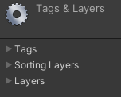
Tag, Layers & Sorting Layers

Slide 5
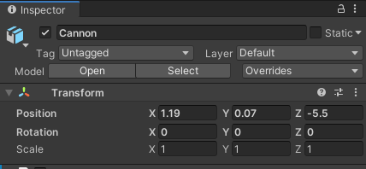
Tag, Layers & Sorting Layers
Tags
A way to sort from code
Layers
A way to sort from Unity
Sorting Layers
A way set rendering order

Slide 6

Mesh, Model, Importing & Prefabs

Slide 7
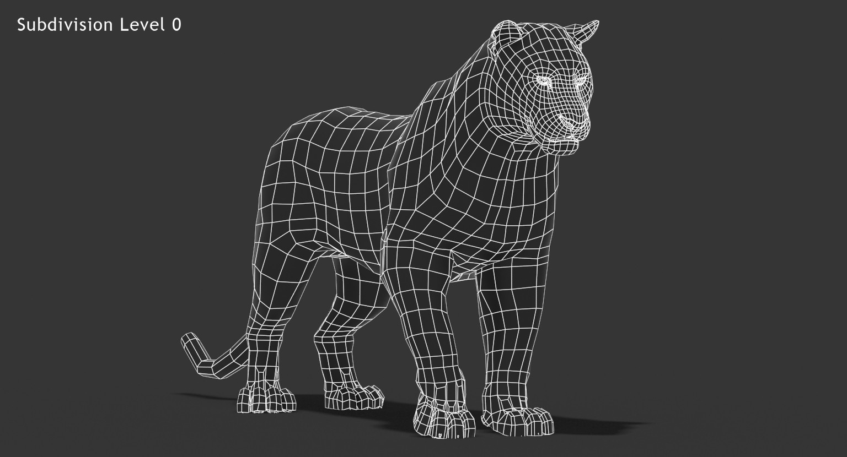
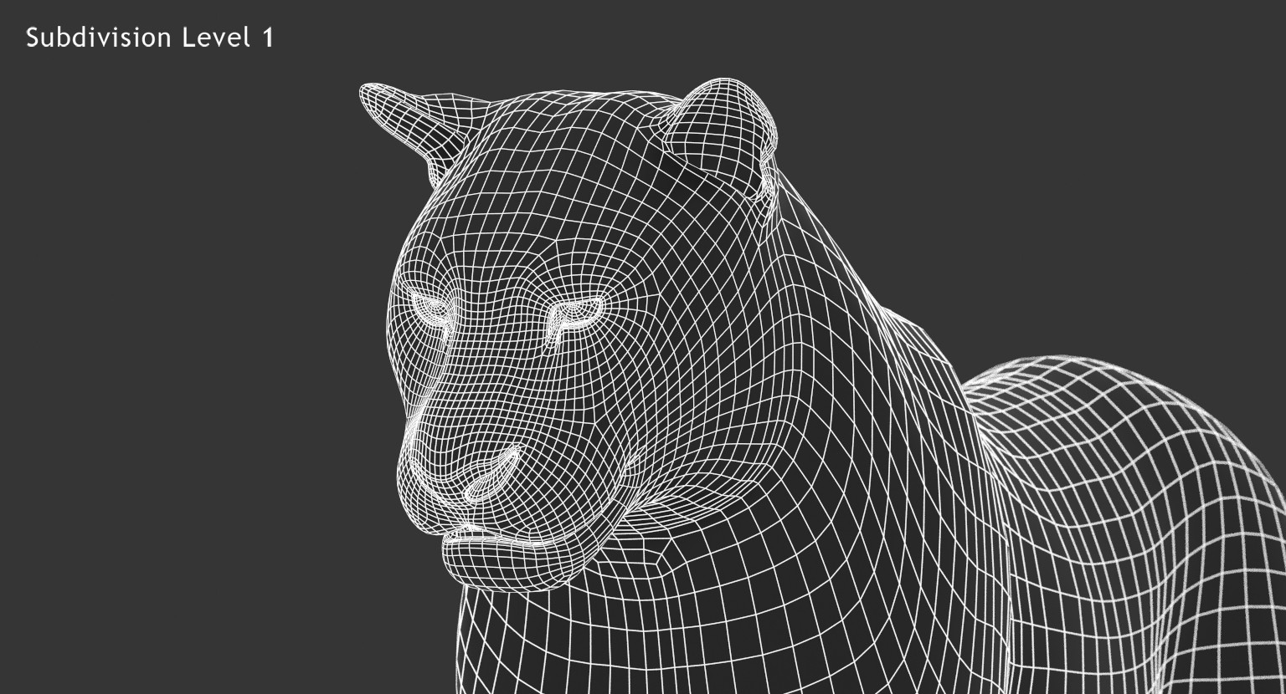
What exactly is Mesh?
Polygons/Faces
Edges
Vertices

Slide 8

What is Model?
Mesh
Materials
Animations
Popular formats
.fbx, .3ds, .mb, .obj

Slide 9
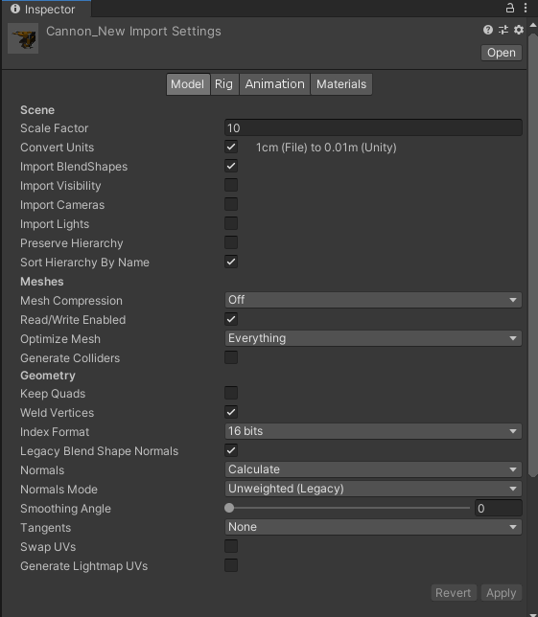
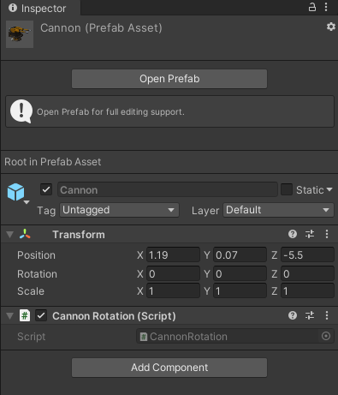
Importing & Prefabs
Model
Rig
Animation
Materials
Model vs Prefab

Slide 10
How to use Prefabs & Models
Pre-adding to scene
Just drag and save the scene
Loading from Resources
Resources.Load();
Downloading from remote location/Isolated Storage
UnityWebRequest
Runtime importing
From StreamingAssets/From remote location

Slide 11
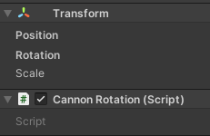
Components & basic operations

Slide 12
Basic component scripting
Adding, removing & getting
public class ComponentExample : MonoBehaviour
{
void Start()
{
// Get component
var collider = GetComponent<Collider>();
// Add component
var collider = gameObject.AddComponent<Collider>();
// Remove component
Destroy(GetComponent<Collider>());
}
}

Slide 13
Basic component scripting
Searching for component
void Start()
{
// Find component somewhere in children (first found returned)
var collider = GetComponentInChildren<Collider>(true/false);
// Find components somewhere in children (first found returned)
// Returns Array[T]
var colliders = GetComponentInChildren<Collider>(true / false);
// Search in the scene for Collider
var collider = FindObjectOfType<Collider>();
// Search in the scene for Colliders
// Returns Array[T]
var colliders = FindObjectsOfType<Collider>();
}

Slide 14
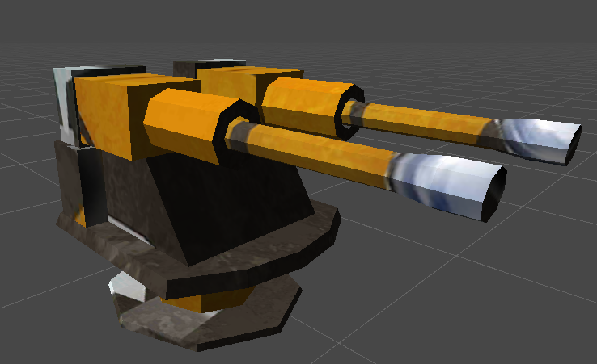
GameObject most used properties & methods

Slide 15
GameObject most used properties & methods
// Indicates if it’s “really” active
gameObject.activeInHierarchy;
// Indicates if it is active.
// Parent can still be inactive.
gameObject.activeSelf;
// Scans all scripts attached.
// If it finds a method
// with that name it executes
gameObject.SendMessage("SomeMethod");
// Self explanatory :)
gameObject.SetActive(true);
// Searches for a GameObject with that name
var weapon = GameObject.Find("Weapon_1");
// Searches for a GameObject with that Tag
var enemy = GameObject.FindGameObjectWithTag("Enemy");
// Searches for a GameObjects with that Tag
// Returns Array[GameObject]
var enemies = GameObject.FindGameObjectsWithTag("Enemy");

Slide 16

Unity Input

Slide 17
Unity Input
Input Manager
Input class and popular methods
Input.GetKey
Input.GetMouseButton
Input.mousePosition
Input.touches
Up vs Down events
Event. Current
Platform Dependent Compilation

Slide 18

Cannon Ball (Lab)

Slide 19
Lab specific methods
Camera.ScreenPointToWord()
Convert mouse coordinates to 3D coordinates
Vector3.Lerp()
Progress b/n two positions
Random.Range()
Random float b/n passed limits
GameObject.Instantiate()

Slide 20

Deployment

Slide 21
Most common types
Standalone
Builds a folder with .exe file and bunch of resources
Android
Requires Android SDK/NDK installed
Build either APK or ABB file
iOS
Requires Mac (hackintosh)
Unity generates XCode project
Actual building happens in XCode

Slide 22
Useful Links
http://docs.unity3d.com/Manual/Inspector.html
http://docs.unity3d.com/Manual/Prefabs.html
http://docs.unity3d.com/Manual/HOWTO-importObject.html
http://docs.unity3d.com/ScriptReference/Component.html
http://docs.unity3d.com/Manual/class-InputManager.html
http://docs.unity3d.com/ScriptReference/Input.html

Slide 23

Summary
Tag, Layer, Sorting Layer
Mesh, Model, Importing & Prefabs
Components & basic operations
GameObject most used properties & methods
Unity Input
Deployment
Useful links
Notes:
23

Slide 24
Questions?
Notes:
24

Slide 25











SoftUni Diamond Partners
25
Notes:
25

Slide 26



Educational Partners
26
Notes:
26

Slide 27

License
This course (slides, examples, demos, exercises, homework, documents, videos and other assets) is copyrighted content
Unauthorized copy, reproduction or use is illegal
© SoftUni – https://about.softuni.bg
© Software University – https://softuni.bg
Notes:
27

Slide 28
Trainings @ Software University (SoftUni)
Software University – High-Quality Education, Profession and Job for Software Developers
about.softuni.bg, softuni.org
Software University Foundation
softuni.foundation
Software University @ Facebook
facebook.com/SoftwareUniversity
Software University Forums
forum.softuni.bg
Notes:
28

